Slide 1
Scientific Programming in Python
NDP Mini-course
Matt Budde, PhD
Aug 26 2024

Slide 2
Mini-course Outline
Intro to python: why, installation, how to, …
Python language basics (google colab and jupyter notebook)
Variables, conditional statements, loops, functions, imports, etc…
Example problems
Python for figures
Getting started for yourself

Slide 3
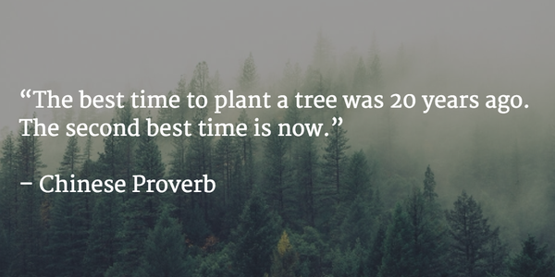

Slide 4
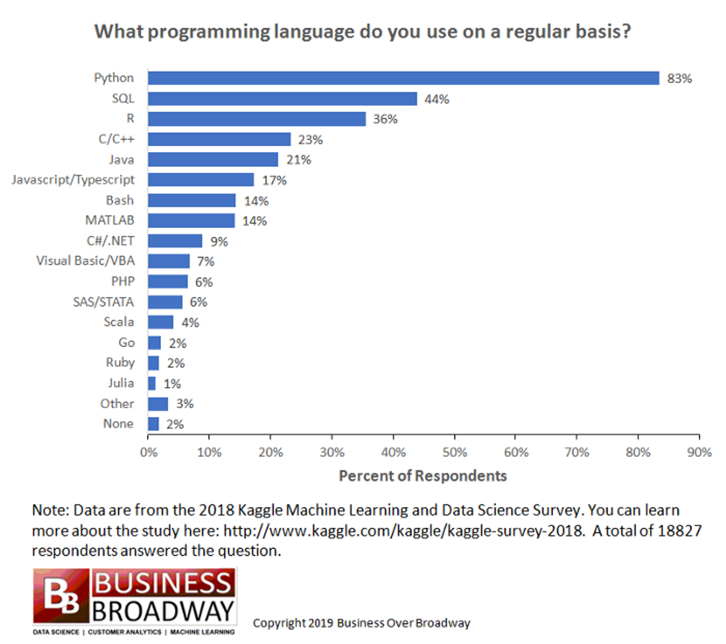
Why python?
Popularity
Broadly used in scientific programming.
Very easy to get started
Ample resources
Many may have already used it.
Why not python?
slow(er)
Not ideal for computationally-intensive tasks
Many versions/variants, decentralized

Slide 5
Programming in python (IDE)
Jupyter-(lab/notebook): browser-based tool to run scripts and portions of scripts
Very useful & intuitive to get started
Not as easy for efficient programming (non-interactive programs)
Interactive development environment (IDE): software to assist programming, running code, debugging, etc
Useful for more intensive tasks
Typically programs that access files or run for longer times.
Visual Studio VS Code, Spyder, etc

Slide 6
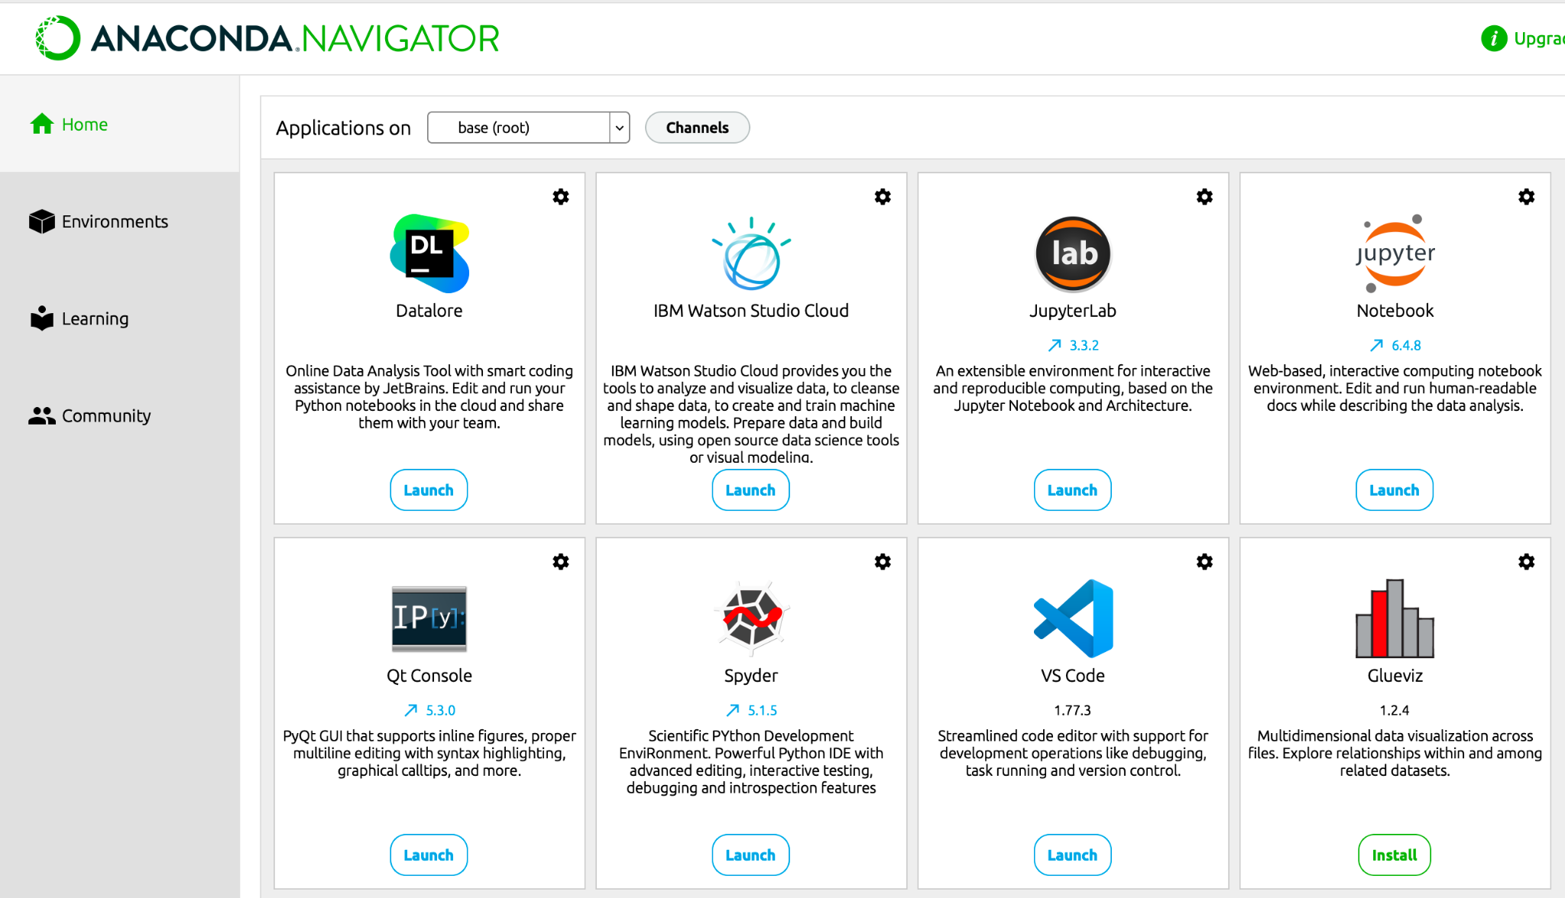
Using/installing python
Use an installer such as Anaconda
Interfaces with several software packages
Jupyter (lab/notebook)
Spyder or VS Code

Slide 7
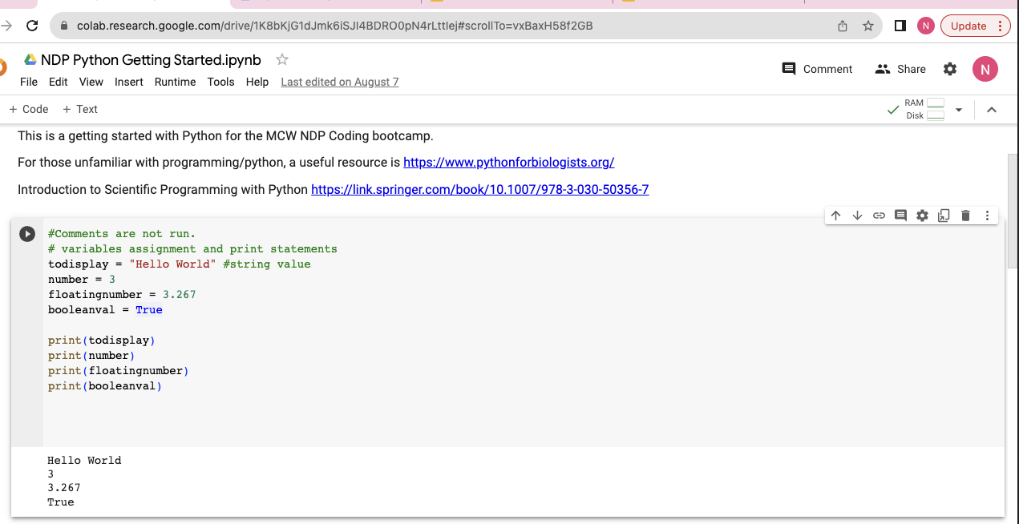
Jupyter notebook: Google colab.
computer/kernel
run
editor
output

Slide 8
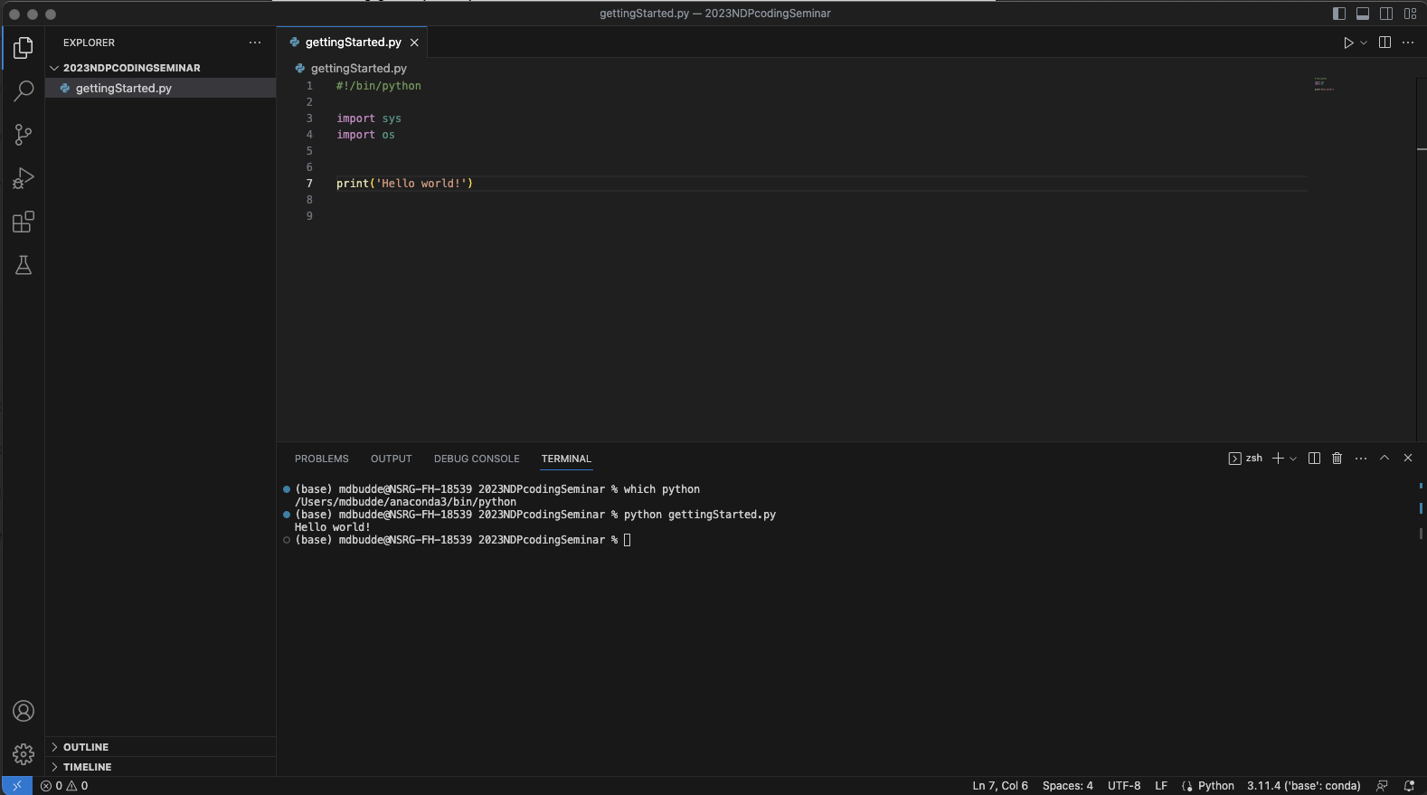
IDE: Visual Studio Code
editor
File browser
terminal

Slide 9
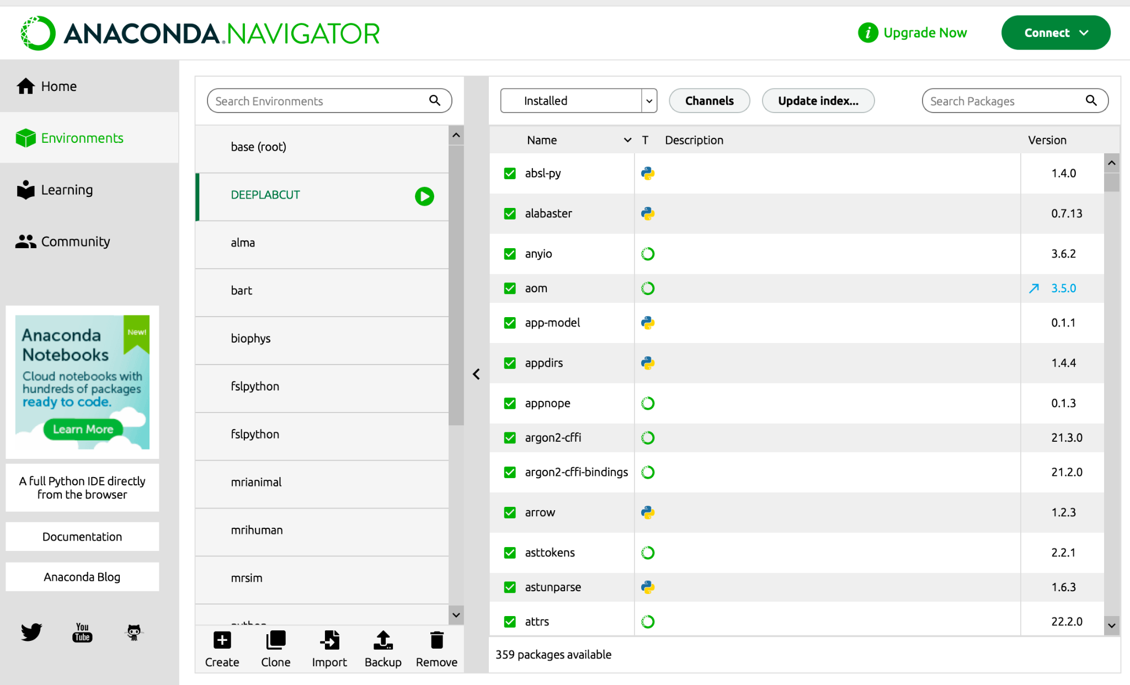
Anaconda example
Conda maintains different environments
Avoids conflicts and keeps versions organized
For example, DeepLabCut was developed with specific package versions.
Other code likely use different packages and versions of the same package.
Especially in python, versions matter.
pip: Python package installer

Slide 10
Getting started in the lab:
Like most other things, programming is a tool to help your science.
Use it to do what you need/want to get done.
- Accelerate tasks that you would otherwise do slower/manually.
- Alter code to achieve things that it currently doesn’t.
Find a task in the lab you think is feasible to accomplish in a few hours or days.
Choose something that will actually help you, not simply something as a tutorial.
Pick something with a definite endpoint; not just didactic learning.
Do not write from scratch! Steal, borrow, beg, for similar code that you can modify.
Examples,
Convert formatted files from other programs (behavior, flow cytometry, etc..) into a single dataset for statistical analysis
Replacing cut/paste steps in other programs (Excel)
Create and re-create figures from data.
Other options…
ChatGPT-> start using it, like now!

Slide 11
Saving, Documenting, Sharing
Maintain good laboratory practices for storing and documenting code.
Reproducibility is key, be able to re-run the same code.
How to store code:
Most often, store it with the data to be processed (always backup!)
Repositories (github) are useful for collaborating & versioning.
Example: https://github.com/mdbudde/RatSpinalCordMRIpipeline
Just get started, but routinely consider workflow and ways to improve.

Slide 12
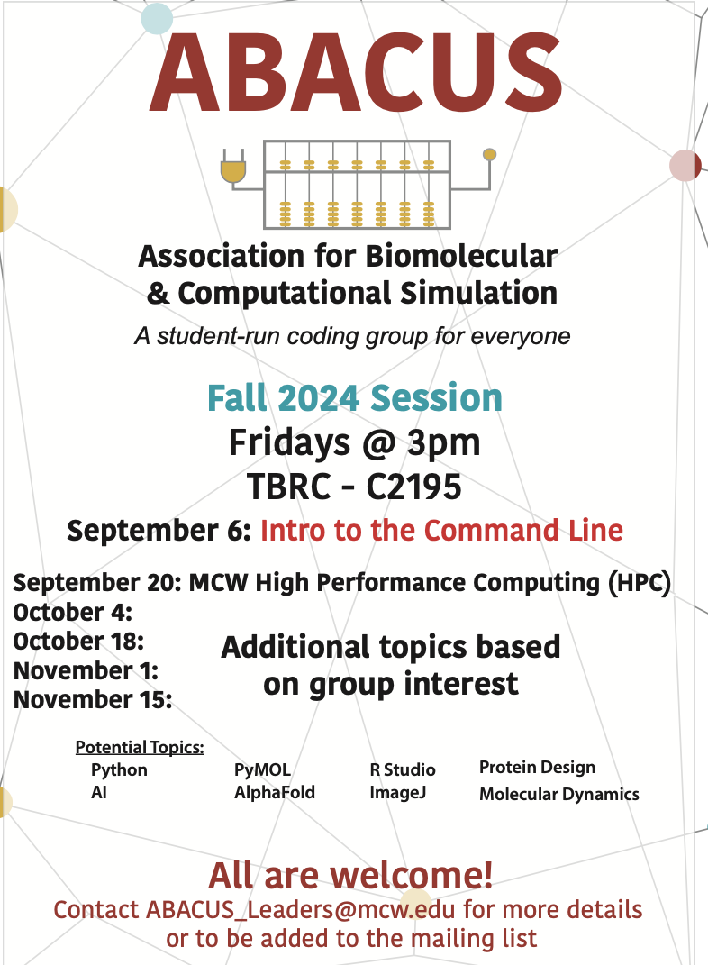
MCW Student Resources
Our first session will be held
Friday, September 6th at 3pm in C2195 (TBRC).

